Slide 1
Student Complaints and Concerns
October 23, 2023

Slide 2
Agenda
Recap August 8 Session
Describe the process for faculty and staff to document complaints
Differentiate between the various concern / complaint processes and explain appropriate use
Address need for students to receive due process
See short demo of CU Succeed and ensure its use for concerns about particular students
Review scenarios to demonstrate appropriate use of various process
Next steps

Slide 3
Recap of August Session
Basic Processes, Referrals, and Resources
Student Concerns and Complaints Web Site
Academic Policies
Students Complaints and Concerns
CARE Team
Student Government Matters and Feedback
Student Non-Academic Grievances
General Complaints
Student Conduct
Sexual Misconduct and Title IX
Americans with Disabilities and Requesting Accommodations
Harassment and Discrimination
Safety, Security and Police

Slide 4
Consider Faculty and Staff Process and Form
Document concerns and complaints received in administrative and academic offices using the CU Concern/Complaint form
Consider complaints that are of general administrative concerns, operational matters, and behaviors that require action
Do not generally report offhand comments or casual conversation
Use CU Succeed if you have a concern about a particular student
Do not duplicate complaints that you know have been submitted via another process (e.g., Title IX, Student Conduct, etc.)
Enter multiple complaints received on the same topic in one submission
If in question, report concern or ask questions to appropriate office
Notes:
Thank you Suzy. So, during our session last time and after we met, questions were raised about what folks should do with those general complaints and concerns that may be expressed by students, parents, faculty, staff, and public at at large across various offices on campus, especially those offices that are student- or public-facing and tend to draw in comments and complaints. We did talk about making the complainant aware of the appropriate process so they can, if needed, file a formal complaint. BUT, some of you asked Should we record them and if so how/where would we do that since we know a complaint may indicate the need for a change, but the individual frequently does not formalize the complaint.
Our core presenter group met and really identified that these questions illuminated the need for a process not addressed by the August 8 session or by any systematic process at CU, but should be. There is a need, some of it relates to compliance with federal law and some relates to good practice, to have a process whereby faculty and staff document concerns expressed to them at the unit level by key constituencies, ensure those concerns are resolved, if necessary and possible most immediately, and /or referred as appropriate. We also want to make sure the any underlying causes for the complaint are addressed and, with periodic review those concerns, determine if trends exist that point to opportunities for improvement.
To document those concerns or complaints at the unit level, we ask that you use the CU Concern and Complaint form on the web (it does require SSO). [DROP WEB SIT LINK IN CHAT] The key points on this slide provide some direction but are also located in the introduction on the form . So I will move away from the slide deck and use the form for moment.
This form is for faculty and staff use only in those academic and administrative offices who receive concern / complaints – which quite frankly could be any of our offices. As stated in the second paragraph, the complaints would be of general administrative concerns, operations, access to resources, etc. - so an example may be one or more parents calling into admissions that insufficient signage and parking was available for open house, instructions for securing graduation tickets were unclear and I don’t know where to go, hours of operation for dining hall, student success center, recreation center, fill in blank begin too late or end too early, or when I call XYZ office, no one answers or responds to my voice message., or I went to the XYZ office during working hours. The doors were locked, and I couldn’t find anyone to help me. They are contacting you with intentionality to lodge a complaint or voice a concern – So it is not offhand comments or casual conversation - well it’s raining out and here was no parking in the lot closest to my 8 a.m. class this morning – what a bummer; how distressing. Not talking about that.
Want to be very clear – that if a concern is raised about a particular student that you record those kinds of concerns in CU Succeed and Jess Heid will address that here shortly.
The last full paragraph include a couple other pointers about (1) documenting multiple complaints of the same or similar nature in one entry and (2) not documenting those that you know with assurance have already been filed in another process – there are links directly on the form to some of those processes
So if you scroll, you will see that the form requests general background information from you the person completing the form (again this should be a faculty or staff member) and the incident. and we encourage you to review these fields, ask questions, or provide clarification. Then, provide more detailed information below about the complainant and others involved if appropriate, the concern itself, what if any action was taken including the description of that action. You can include any supporting documentation (maybe an email received). Email yourself and then hit submit.
If in doubt, please record the concern – if no action is needed that’s fine. And, if you think this falls under another specific policy but are unsure, please feel free to reach out to the appropriate office.
Next slide includes some contact information.
This slide is here as a resource. Turn it over to George.

Slide 5
General Offices / Contacts
Area | Contact | Phone | Email
Academic Policies and Procedures | Dr. Kara Shultz, Vice Provost | 570-389-3803 | viceprovost@commonwealthu.edu
Student Complaints and Concerns | George Rusczyk, Dean of Students, | 570-389-4734 | deanofstudents@commonwealthu.edu or grusczyk@commonwealthu.edu
Student Conduct | Mr. Zachary Dubord, Executive Director of Student Conduct | 570-389-4734 | deanofstudents@commonwealthu.edu or zdubord@commonwealthu.edu
CU Succeed | Ms. Jessica Heid, Early Alert Technology System Manager | 570-389-3862 | jheid@commonwealthu.edu
Americans with Disabilities Act | Ms. Tesse Fosse, ADA Coordinator | 570-389-4529 | tfosse@commonwealthu.edu
Sexual Misconduct and Title IX | Ms. Jen Raup, Title IX Coordinator | 570-389-4808 | titleixcoord@commonwealthu.edu or jraup@commonwealthu.edu
Harassment and Discrimination Employees | Ms. Tena Maurer, AVP for Human Resources and Labor Relations | 570-389-4590 | TMaurer@commonwealthu.edu
Harassment and Discrimination Students | Mr. Albert Jones, Chief Diversity, Equity and Inclusion Officer | 570-484-2015 | ajones@commonwealthu.edu
Safety and Security | University Police Department on the campuses | 570-389-2211 @Bloomsburg 570-484-2278 @Lock Haven 570-662-4900 @Mansfield
Notes:
This slide is here as a resource. Turn it over to George.

Slide 6
Differentiate Between Complaint Processes
Emergencies:
An emergency situation is an urgent, unexpected, and usually dangerous situation that requires immediate action. It can pose an immediate risk to health, life, property, or the environment
All categories of concerns/complaints that are an Emergency should be directed to Campus Police immediately.

Slide 7
Differentiate Between Complaint Processes
When should I use the various reporting options:
Incident Report:
Non-Emergency or Post Emergency violations of the Student Code of Conduct.
Examples include: Physical Harm, Harassment, Drugs, Alcohol, Hazing, Safety Violations, Theft, Threat of Harm, Unauthorized Access, Vandalism, Weapons
Title IX Report:
Non-Emergency or Post Emergency violations of the Sexual Misconduct Policy.
Examples include: Dating Violence, Domestic Violence, Sexual Assault, Sexual Penetration Without Consent, Sexual Contact Without Consent, Statutory Sexual Assault, Sexual Exploitation, Sexual Harassment, Stalking
Student of Concern Report:
Always Non-Emergency
Examples include: prolonged absence from campus, impacts of medical or personal emergencies, resource insecurities, mental health or behavioral concerns, help connecting to resources both on campus or locally

Slide 8
Managing Student Expectations
Do not promise a certain outcome to the student.
We appreciate your help in setting realistic expectations for the process and the potential outcomes.
If you are not sure – don’t create false expectations for the student. It is better to refer to the correct office rather than give incorrect information.
Remember that some processes have steps that must be done prior to moving on.

Slide 9
Address Need for Due Process
What is Due Process?
Fair procedures must be followed before someone accused of wrongdoing is found responsible and punished. It includes both fair procedure (procedural due process) and a fair outcome (substantive due process).
Procedural Due Process
The nature and amount of procedural due process should increase with the severity of the penalty.
Substantive Due Process
Making a decision that can be defended rationally (for our purposes: it satisfies some legitimate educational objective).
What Does that mean for Us?
Follow our processes/policies
Document the process
Allow students to be “heard” in all cases
Allow students a formal hearing in cases where we are taking away something significant.

Slide 10
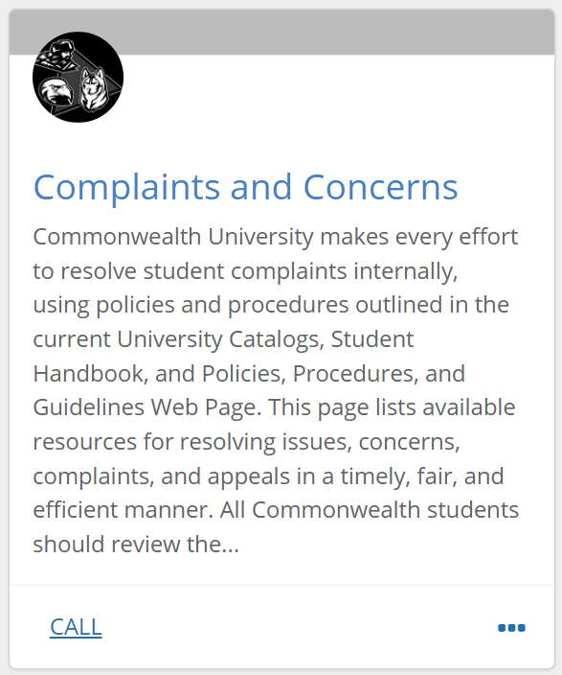
Use CU Succeed Regarding a Particular Student
Your Name

Slide 11
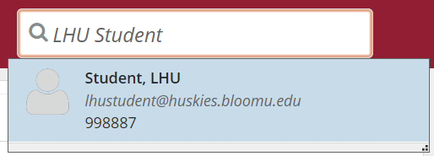
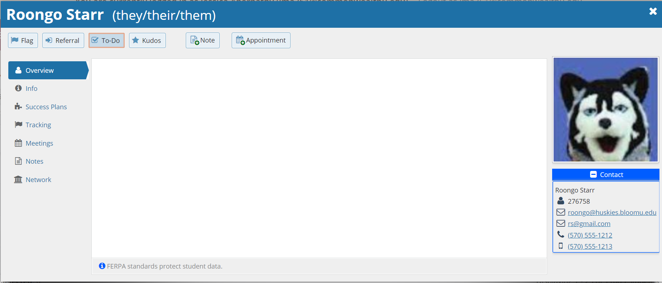
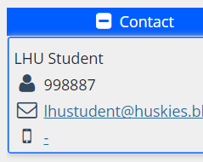
Use CU Succeed Regarding a Particular Student
P11051106
lhs@lockhaven.edu
P11051106
lhs@lockhaven.edu
Image by rawpixel.com

Slide 12
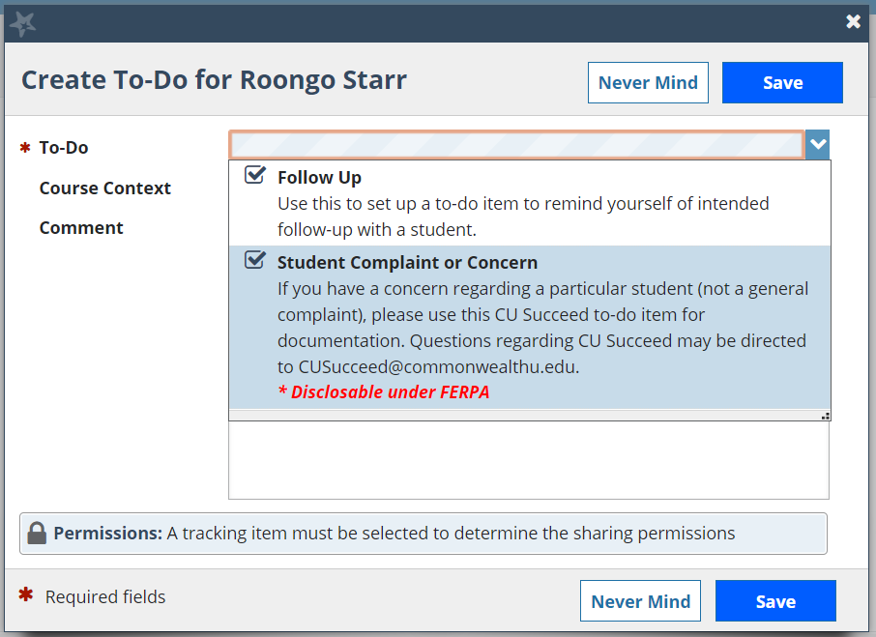
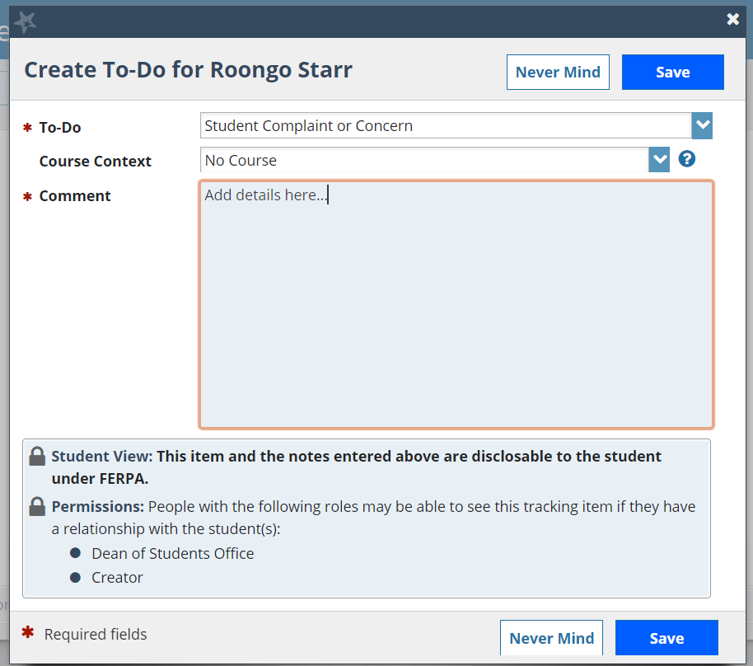
Use CU Succeed Regarding a Particular Student
Image by rawpixel.com

Slide 13
Review Scenarios
How do you report these Situations?
A student who is meeting with you discloses some housing and food insecurity issues, they also let you know that had suffered a sexual assault at off campus residence last weekend.
A student is not attending class and says that they do not want to wake up for the 8am class, they also disclose that they do not know how to study for tests.
A student is not attending their 8am class due to an unexpected illness of their parent which requires them to assist with getting a younger sibling to school.
A student approaches you to let you know that another student has threatened to “end him” if he doesn’t give him his completed problem sheets for class.

Slide 14
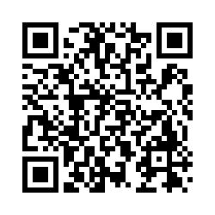
Next Steps
Use the faculty and staff form and process as appropriate
Engage in high-level, periodic reporting
Builds in foundation for continuous improvement
Addresses compliance requirements
Demonstrates institutional accountability to key stakeholders
Build into onboarding
Provide feedback on process via the survey

Slide 15
Questions and Answers

